Slide 1
DIRECT VENDOR INVOICE MANAGEMENT
Mini SAP Application
By Abhijith, Ankit, Alpana, Jaydeep

Slide 2
Database Flow Chart

Slide 3
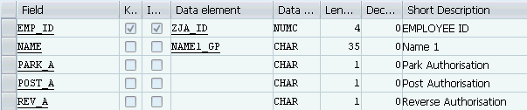
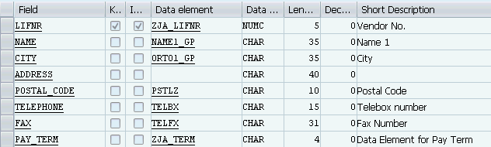
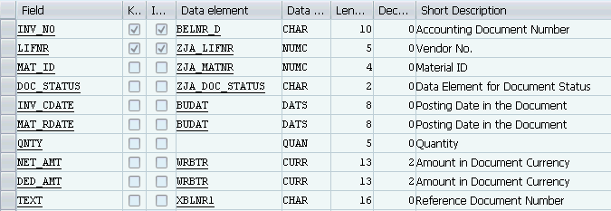
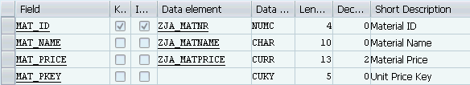
Authorisation Master Table
Vendor Master Table
Invoice Transaction Table
PK
FK
FK
Material Master Table
PK

Slide 4
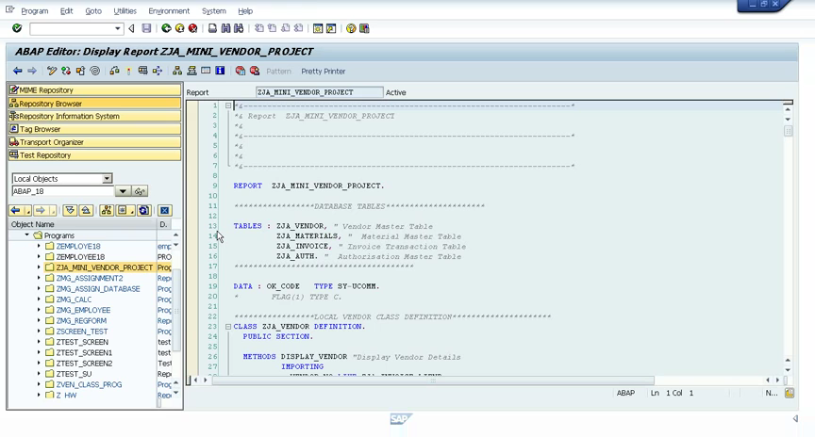
PROJECT DEMO

Slide 5
THANK YOU!!

